Slide 1
Non-Parametric Hypothesis Testing
Non-Parametric Hypothesis Testing?

Slide 2
Learning Objectives
On completing this Chapter, you should be able to:
Apply a range of non-parametric tests to solve a range of problems. These include: sign test, Wilcoxon signed rank t-test for two paired samples, and the Mann-Whitney U-test for two independent samples.
Solve problems using Microsoft Excel and IBM SPSS Statistics software packages.

Slide 3
Introduction
In Chapter 7, we explored a series of parametric tests to assess whether the differences between means (or variances) are statistically significant. Within parametric tests we sample from a distribution with a known parameter value e.g. population mean (μ), variance (σ²), or proportion (ρ). The techniques described in Chapter 6 were defined by three assumptions:
The underlying population varies as a normal distribution.
The level of measurement is of equal interval or ratio scaling.
The population variances are equal.
Unfortunately, we will come across data that does not fit these assumptions. How do we measure the difference between the attitudes of people surveyed in assessing their favourite brand, when the response by each person is of the form: 1, 2, 3,……, n? In this situation, we have ordinal data in which taking differences between the numbers (or ranks) is meaningless.

Slide 4
Which parametric statistical tests covered in this text book (Excel, SPSS)
Table 8.1 provides a list of chi square or non-parametric statistical tests described in this textbook together with identification of which methods are solved via Excel and SPSS.
Statistics test | Excel | SPSS
Chi-square test of independence test | Yes | Yes
Chi-square test for two proportions (independent samples) test | Yes | Yes
McNemar’s test for the difference between two proportions (dependent samples) test | Yes | Yes
Chi-square goodness-of-fit test | Yes | Yes
Sign test | Yes | Yes
Wilcoxon signed rank sum test for matched pairs | Yes | Yes
Mann-Whitney test for two independent samples | Yes | Yes

Slide 5
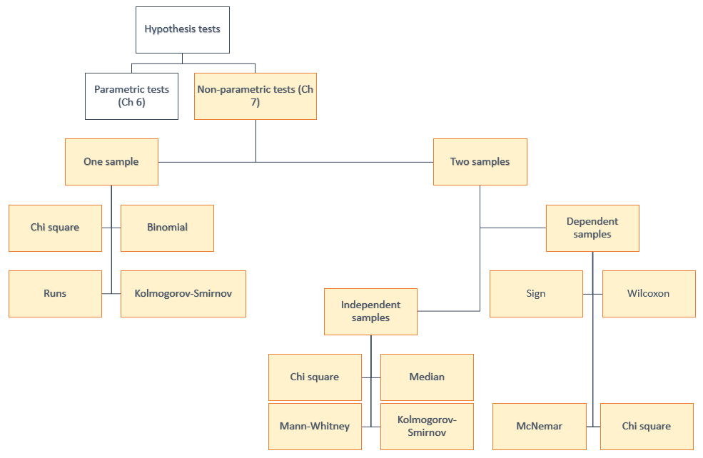
Choosing a Test

Slide 6
Non-Parametric Tests (1/2)
Many statistical tests require that your data follow a normal distribution. Parametric statistical hypothesis tests assume that the data on which they are applied possess certain characteristics or parameters:
The two samples are independent of one another.
The two populations have equal variance or spread.
The two populations are normally distributed.
There’s no getting around assumption 1. That assumption must be satisfied for a t-test. When assumptions 2 and 3 (equal variance and normality) are not satisfied but the samples are large (say, greater than 30), the results are approximately correct. But when our samples are small and our data is skewed or non-normal, we probably shouldn’t place much faith in the t-test.
This is where non-parametric tests come in given they can solve statistical problems where assumptions 2 and 3 are violated. Whereas the null hypothesis of the two-sample t test is equal means, the null hypothesis of non-parametric tests test for equal medians.

Slide 7
Non-Parametric Tests (2/2)
In this section, we shall explore three non-parametric tests: sign test, Wilcoxon signed rank test, and Mann Whitney U test. Table 8.22 compares the non-parametric tests with the equivalent parametric tests for one and two sample tests discussed in Chapter 7.
Test | Parametric test | Non-parametric test
One sample | One sample z test One sample t test | Sign test Wilcoxon signed-rank test
Paired samples | Two paired sample z test Two paired sample t test | Sign test Wilcoxon signed rank test
Independent samples | Two independent sample t test | Mann Whitney U test (Wilcoxon rank sum test)

Slide 8
The Sign Test
The sign test is used to test the null hypothesis that the median of a distribution is equal to some value. It can be used (a) in place of a one-sample t-test, (b) in place of a paired t-test or (c) for ordered categorial data where a numerical scale is inappropriate but where it is possible to rank the observations.
Sign test assumptions
The sign test is a non–parametric (distribution free) test, so we do not assume that the data is normally distributed.
Data should be from two samples. The population may differ for the two samples.
Dependent samples should be a paired sample or matched.
Types of sign test
One sample: We set up the hypothesis so that + and – signs are the values of random variables having equal size.
Paired sample: This test is also called an alternative to the paired sample t-test. This test uses the + and – signs in paired sample tests or in before-after study. In this test, null hypothesis is set up so that the sign of + and – are of equal size, or the population means are equal to the sample mean.

Slide 9
Explanation
The observations in a random sample of size n are x₁, x₂,..., x_{n} (these observations could be paired diﬀerences); the null hypothesis is that the population median is equal to some value M.
Suppose that r₊ of the observations are greater than M and r₋ are smaller than M (in the case where the sign test is being used in place of a paired t-test, M would be zero).
Values of x which are exactly equal to M are ignored; the sum r₊ and r₋ may therefore be less than n — we will denote it by n’.

Slide 10
Hypothesis Statements
Under the null hypothesis we would expect half the x’s to be above the median and half below. Therefore, under the null hypothesis both r₊ and r₋ follow a binomial distribution with the probability of success p = 0.5 and n = n’.
Null hypothesis
H₀: Population median M = assumed population median value M_{a}
Alternative hypothesis
H₁: Population median M > assumed median value M_{a}
H₁: Population median M < assumed median value M_{a}
H₁: Population median M ≠ assumed median value M_{a}

Slide 11

Binomial exact solution equations
In this case the probability distribution is a binomial distribution with the probability (or proportion) of success = 0.5 and the number of trials represented by the number of paired observations (n). In this case we can model the situation using a binomial distribution X ~ Bin (n, p). The value of the binomial probability is given by equation (8.14)
This value given by the binomial equation represents an exact p-value. The p-value for a sign test is found using the binomial distribution where r = proportion of non-zero values = 0.5, n = number of non-zero differences, and x = number of positive differences:
Upper one-tail: p > 0.5, p-value = probability that x is greater than or equal to x = P(X ≥ x)
Lower one-tail : p < 0.5, p-value = probability that x is less than or equal to x P(X ≤ x)
Two-tail: p ≠ 0.5, p-value = twice the probability that x is greater than or equal to x = 2*P(X ≥ x)

Slide 12
Example 8.5 (1/6)
To illustrate the concept, consider a sales manager who oversees 16 inside and 16 outside sales representatives.
Every inside sales representative is paired with an outside sales representative.
After interviewing all of them, the sales manager assigns the values to the level of understanding that every inside and every outside sales person have of their shared territories (see Table 8.23).
T | A | B | T | A | B
1 | 3 | 4 | 9 | 4 | 5
2 | 4 | 3 | 10 | 5 | 4
3 | 3 | 5 | 11 | 2 | 4
4 | 5 | 3 | 12 | 2 | 1
5 | 3 | 2 | 13 | 4 | 3
6 | 5 | 3 | 14 | 5 | 2
7 | 1 | 2 | 15 | 2 | 5
8 | 4 | 2 | 16 | 4 | 5
The mark of 1 means great insight and the mark of 5 means little or no insight.
The null hypothesis statement is that there is the same level of understanding and insight of their respective territories among the inside and outside sales people. The alternative hypothesis is that the outside sales staff have a different insight compared to the inside sales staff.

Slide 13
Example 8.5 (2/6)
Step 1 - State hypothesis
H₀: The median of the differences is zero.
H₁: The median differences are different.
Two tail test
Step 2 - Select test
Two dependent samples, both samples consist of ordinal data, and no information on the form of the distribution.
Conduct signed test.
Step 3 - Set the level of significance (α = 0.05)

Slide 14
Example 8.5 (3/6)
Step 4 - Extract relevant statistic
Territory | A (Inside) | B (Outside) | D = B - A | Sign
1 | 3 | 4 | 1 | +
2 | 4 | 3 | - 1 | -
3 | 3 | 5 | 2 | +
4 | 5 | 3 | - 2 | -
5 | 3 | 2 | - 1 | -
6 | 5 | 3 | - 2 | -
7 | 1 | 2 | 1 | +
8 | 4 | 2 | - 2 | -
9 | 4 | 5 | 1 | +
10 | 5 | 4 | - 1 | -
11 | 2 | 4 | 2 | +
12 | 2 | 1 | - 1 | -
13 | 4 | 3 | - 1 | -
14 | 5 | 2 | - 3 | -
15 | 2 | 5 | 3 | +
16 | 4 | 5 | 1 | +
Sales manager’s marks for inside sales people A and outside sales people B.
Calculate the differences (d = B – A)
State the sign (+ or --) for each paired difference.

Slide 15
Example 8.5 (4/6)
Median difference d = - 1.0
  "Median difference d=median" ("1, −1, ……, 1" )"= −1"
  The median difference for B – A is equal to - 1.0, which suggests that the understanding from the outside sales staff is less than the inside sales staff.
Allocate ‘+’ and ‘-‘depending on whether d > 0 or d < 0
  Total number of trials, n = 16
  Number of – (negative ranks), r₋ = 9
  Number of + (positive ranks), r₊ = 7
Calculate number of paired values, rank data, and find x and n’
  Number of values with d equal to zero, n₀ = 0
  Calculate x = MAX(r₋, r₊) = MAX (9, 7) = 9
  Adjust n to remove the number of values with d equal to zero, n’ = n – n₀ = 16

Slide 16
Example 8.5 (5/6)
Calculate binomial probabilities, P(X ≥ x). This problem can be solved exactly given this is a binomial distribution with T successes from n’ trials when the probability of each trial p = 0.5.
  Probability of success, p = 0.5.
  Number of trials, n’ = 16.
  Number of successes, x = 9.
Solve P(X ≥ x) when x = 9, n’ = 16. The corresponding binomial p-value is calculated from equation (8.14)
p-value =
In this case we wish to solve the problem:
P-value = P(X ≥ 9) = P(X = 9, 10, 11, 12, 13, 14, 15, 16)
P-value = P(X = 9) + P(X = 10) + P(X = 11) + P(X = 12) + P(X=13) + P(X=14) + P(X=15) + P(X=16)
  P(X ≥ 9) = 0.402

Slide 17
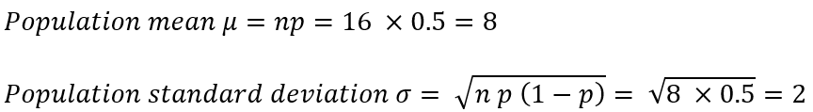

Example 8.5 (6/6)
Make a decision
The one-sided binomial p-value = 0.402 [EXACT solution]
Given we have a two-tail test, then the two-tail binomial p-value = 0.402 x 2 = 0.804
The two-tail p-value = 0.804 > significance level = 0.05
Conclude, we fail to reject the null hypothesis and say we have no significant difference between inside and outside sales staff.
Large sample sign test - Normal approximation
If n is sufficiently large (n > 30), we can use a normal approximation with the value of the population mean and standard deviation given by equations (7.18) and (7.19): n’ = 16, p = 0.5.
Zcri = + 1.96 given two-tail test
Conclude that outside salespeople have a better insight in their sales territory than inside salespeople

Slide 18
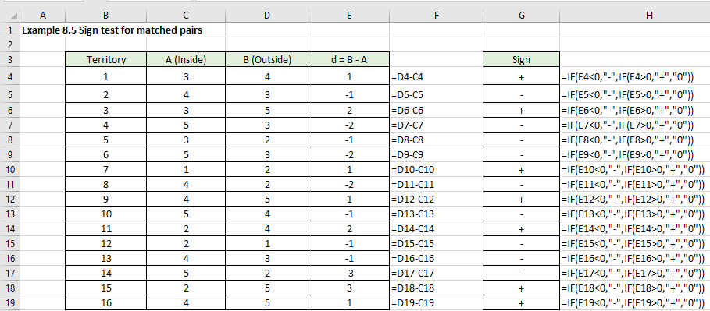
Example 8.5 Excel solution (1/2)

Slide 19
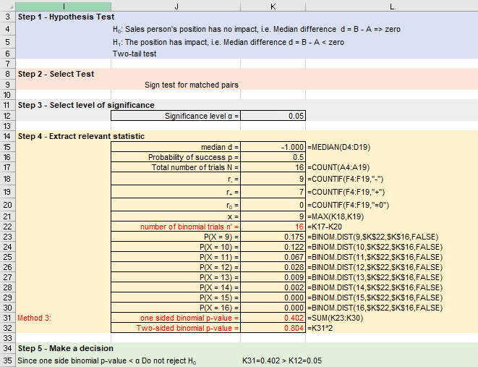
Example 8.5 Excel solution (2/2)
2-tail exact binomial p-value = 0.804 > 0.05
Fail to reject the null hypothesis.

Slide 20
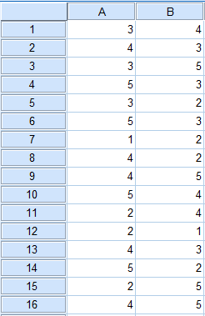
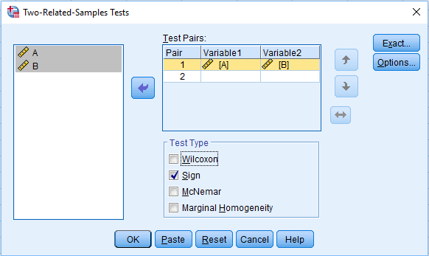
Example 8.5 SPSS solution (1/3)
Enter data
Analyze > Nonparametric Tests > Legacy Dialogs > 2 Related samples
Transfer variables A and B into Test Pairs box

Slide 21
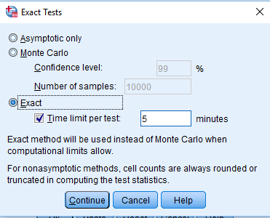
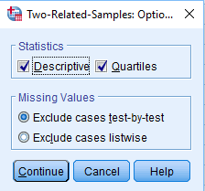
Example 8.5 SPSS solution (2/3)
Click on Exact and choose Exact
Click on Options
Choose Descriptives and select Descriptives and Quartiles
Click Continue
Click Continue
Click OK

Slide 22
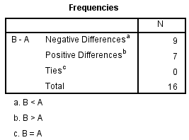
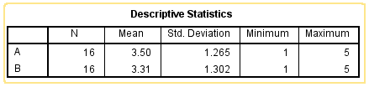
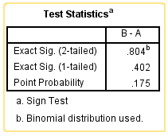
Example 8.5 SPSS solution (3/3)
SPSS output
2 tailed exact binomial p-value = 0.804 > 0.05
Fail to reject the null hypothesis.
Conclude, we fail to reject the null hypothesis and say we have no significant difference between the sales representatives.

Slide 23
Wilcoxon Signed Rank Sum (or matched pairs) Test
The Wilcoxon signed-rank test is the non-parametric equivalent of paired two-sample t-test. It is used in those situations in which the observations ae paired and you have not met the assumption of normality.
The Wilcoxon signed rank sum test assumptions are:
Each pair is chosen randomly and independently.
Data are paired and come from the same population.
The data values are interval data so a ranking can be applied, and differences can be taken.
The distribution of the paired differences is a symmetric distribution.
If the fourth assumption is violated, then you should consider using the Sign Test, which doesn’t require symmetry.
As for the sign test, the Wilcoxon signed rank test is used to test the null hypothesis that the median of a distribution is equal to some value. The method considers the differences between ‘n’ matched pairs as one sample. If the two population distributions are identical, then we can show that the sample statistic has a symmetric null distribution

Slide 24
Solution process
State hypothesis H₀ and H₁.
Calculate the differences between pairs (d = X – Y – D₀).
If the difference between pairs d = 0 then remove this data pair from the analysis.
Record the sign of the difference in one column, the absolute value of the difference in the other column.
Rank the absolute differences from the smallest to the largest.
Reattach the signs of the differences to the respective ranks to obtain signed ranks, then average to obtain the mean rank.
Calculate number of paired values and adjust for shared ranks, n’ = n – n_{s}
Calculate the sum of the ranks, T₋ and T₊.
State T_{cal} = minimum value of T₋ and T₊.
Use statistical tables for the Wilcoxon signed rank test to find the probability of observing a value of T or lower. This is your p-value if the test is one-sided. If your alternative hypothesis is two sided, then double this probability to give the p-value.
For large samples (n > 20), the T statistic is approximately normally distributed under the null hypothesis that the population differences are centered at zero.

Slide 25
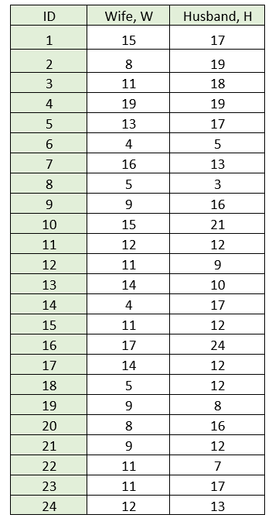
Example 8.6 (1/7)
A study is made to determine whether there is a difference between husbands and wives’ attitudes towards online marketing advertisements. A questionnaire measuring this was given to 24 couples with the results summarized in table above (ordinal range 0 (hate) to 20 (love). Is there a significant difference with the couple's attitude to the online advertisements at a 5% level of significance?

Slide 26
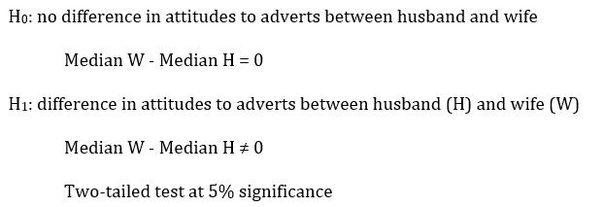
Example 8.6 (2/7)
Step 1 - State hypothesis
Under the null hypothesis, we would expect the distribution of the differences to be approximately symmetric around zero and the distribution of positives and negatives to be distributed at random among the ranks.

Slide 27
Example 8.6 (3/7)
Step 2 - Select test
Two dependent samples.
Both samples consist of interval data.
No information on the form of the distribution.
Wilcoxon signed rank test.
Step 3 - Set the level of significance (α = 0.05)
Step 4 - Extract relevant statistic
The solution process can be broken down into a series of steps:
Calculate the differences (d = X – Y – D₀) and rank data
The convention is to assign rank 1 to the smallest value and rank n’ to the largest value. If you have any shared ranks, then the policy is to assign the average rank to each of the shared values.

Slide 28
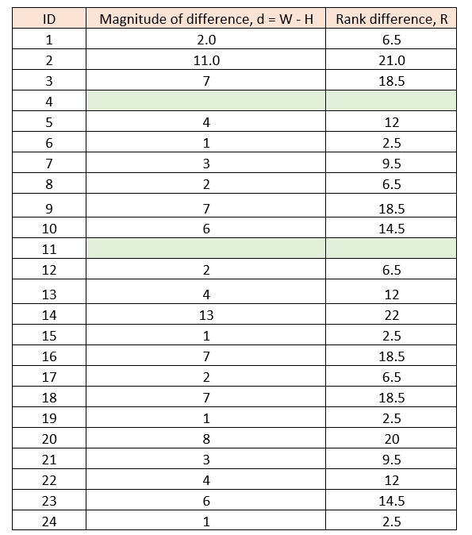
Example 8.6 (4/7)

Slide 29
Example 8.6 (5/7)
Median difference
Median difference d=median (-2 + -11 + -7 + …….. + 4 + -6 + -1) = - 1.5
The median difference is – 1.5 which supports the alternative hypothesis that d ≠ 0. The question then is whether this difference is statistically significant.
Calculate number of paired values
Number of paired ranks, n = 24
Number of data pairs where d = 0 is 2, that is, n₀ = 2.
Adjust n to remove data pairs with d = 0, n′ = n – n₀ = 24 – 2 = 22.

Slide 30
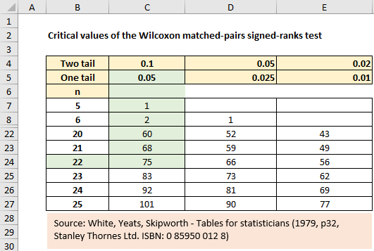
Example 8.6 (6/7)
Calculate the sum of the ranks, T₋ and T₊:
T₋ = Sum of – ve ranks = 6.5+ 21+ 18.5+ 12 + 2.5 + 18.5 + 14.5 + 22 + 2.5 + 18.5 + 18.5 + 20 + 9.5 + 14.5 + 2.5 = 198.5
T₊ = Sum of + ve ranks = 9.5 + 6.5 + 6.5 + 12 + 6.5 + 2.5 +12 = 55.5
T_{cal} = min (T-, T+) = Min(198.5, 55.5) = 55.5
Critical value
From Wilcoxon signed-rank test critical table values, we find for 5% one-tail that the critical value T_{cri} = 75.
Thus, Tcal < Tcri (55.5 < 75), reject the null hypothesis and accept the alternative hypothesis.
Step 5 Make decision.
Based upon the sample data we conclude that there is a significant difference between a wife and her husband’s attitude to online adverts.

Slide 31
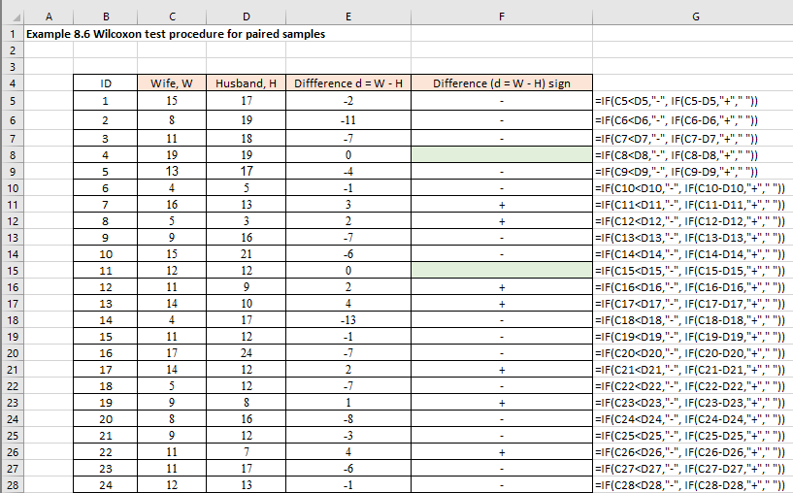
Excel solution (1/4)
Check for difference d = X – Y – D₀ = 0 and remove the data pair from the analysis.
From Figure 8.54 we observe that the fifth data pair as a d = o value. This should be removed to continue the analysis.

Slide 32
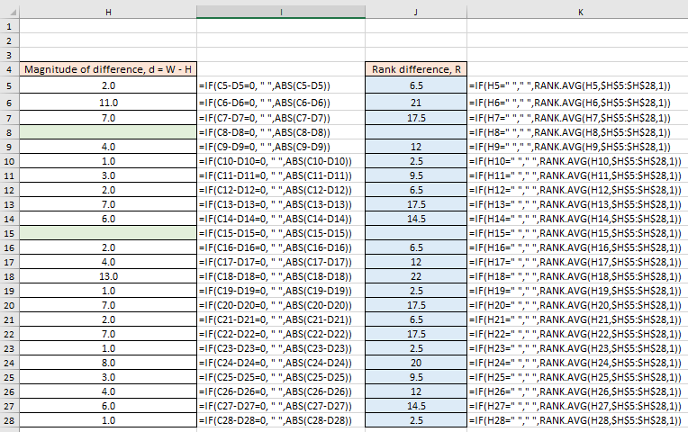
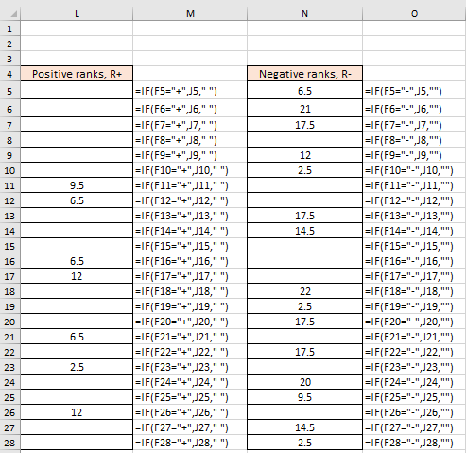
Excel solution (2/4)

Slide 33
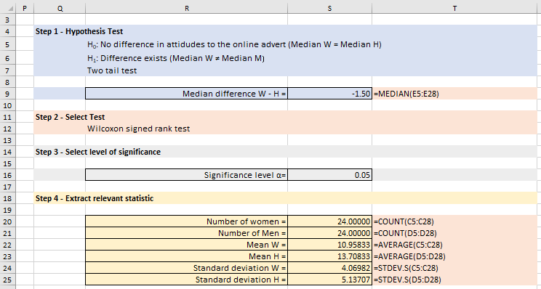
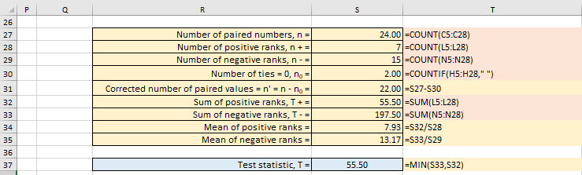
Excel solution (3/4)

Slide 34
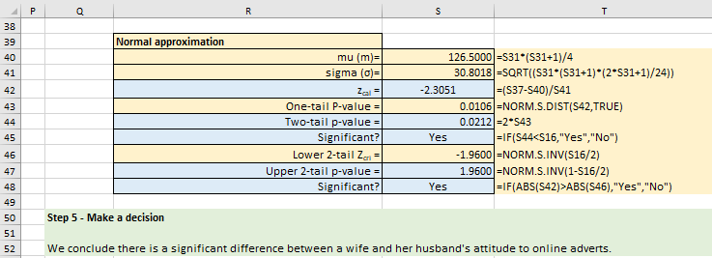
Excel solution (4/4)
Normal approximation
From Excel:
Sigma = 30.81
Zcal = - 2.3051, one-tail p-value = 0.0106 < 0.05

Slide 35
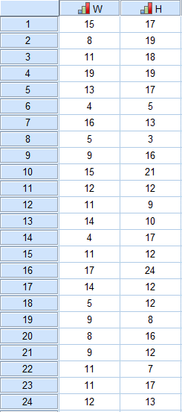
SPSS solution (1/4)
Enter data

Slide 36
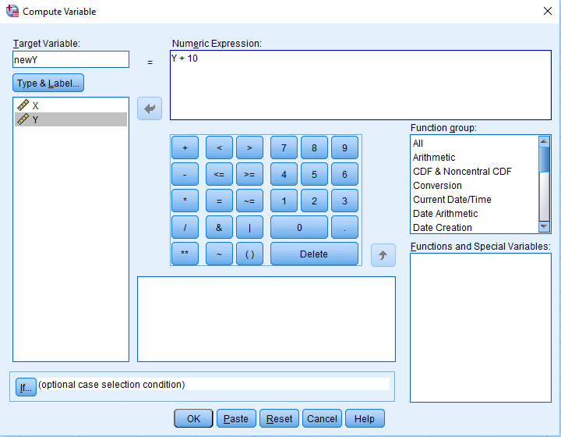
SPSS solution (2/4)
Create a new column in SPSS given H₁: X – Y – D₀ ≥ 0.
The new column will be called newY and will be equal to newY = Y + D₀ = Y + 10.
Click on Transform > Compute Variable
Type newY into the Target Variable box
Click on Y (below Type and Label button) and transfer to the Numeric Expression box
In the Numeric Expression box add +10 to Y
Click on OK

Slide 37
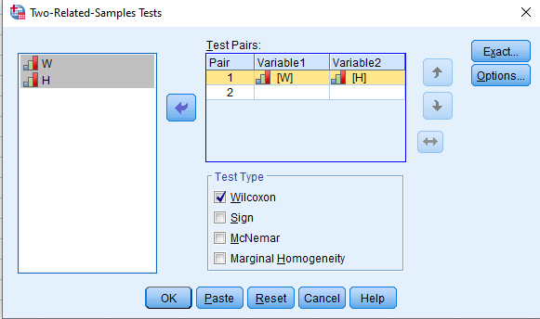
SPSS solution (3/4)
Click on Analyze > Nonparametric Tests > Legacy Dialogs > 2 Related Samples
Transfer X and newY variables to the Test Pairs box
Click on Wilcoxon test.
Click on Exact
Choose Exact
Choose Continue
Click Ok

Slide 38
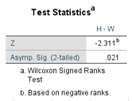
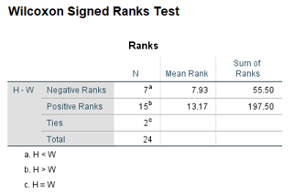
SPSS solution (4/4)
SPSS Output
???????????
1-tail p-value = 0.021/2 = 0.011
From SPSS: T = 35
Asymptotic Z = - 2.311 with a two-tail p-value = 0.001. Therefore, one-tail asymptotic p-value = 0.001/2 = 0.0005, which agrees with the Excel solution.
The exact solution two-tailed p-value = 0.000 which roughly agrees with the asymptotic solution of 0.001.
This suggest that the normal approximation is an appropriate solution.

Slide 39
Mann-Whitney U Test for 2 Independent Samples (1/2)
The Mann-Whitney U test is a non-parametric test that can be used in place of an unpaired t-test. It is used to test the null hypothesis that two samples come from the same population (i.e. have the same median) or, alternatively, whether observations in one sample tend to be larger than observations in the other.
Although it is a non-parametric test it does assume that the two distributions are similar in shape. Where the samples are small, we need to use tables of critical values to find whether to reject the null hypothesis. Where the sample is large, we can use a test based on the normal distribution.
The basic premise of the test is that once all the values in the two samples are put into a single ordered list, if they come from the same parent population, then the rank at which values from sample 1 and sample 2 appear will be by chance. If the two samples come from different populations, then the rank at which the sample values will appear will not be random and there will be a tendency for values from one of the samples to have lower ranks than values from the other sample.

Slide 40
Mann-Whitney U Test for 2 Independent Samples (2/2)
We are thus testing for different locations of the two samples. When you want to compare the distributions in two samples which are independent of each other then you have two tests you can apply: Mann-Whitney U test or the equivalent Wilcoxon rank-sum test. In this section, we will adopt the Mann-Whitney U test method to solve this type of problem. Whenever n₁ and n₂ is greater than 20, a large sample approximation can be used for the distribution of the Mann-Whitney U statistic.
The sample drawn from the population is random.
Independence within the samples and mutual independence is assumed. That means that an observation is in one group or the other (it cannot be in both).
Ordinal measurement scale is assumed.
The Mann-Whitney U test assumptions are as follows:
Although it is a non-parametric test it does assume that the two distributions are similar in shape. This is the nonparametric equivalent test to the two-sample t-test with equal variances.

Slide 41
Solution process
The solution process can be broken down into a series of steps:
Input the two choices into the first column and identify each different group with an identifier.
Input the two sets of data into the next column with each correct identifier attached.
Rank average the combined data set.
Count the number in the first group and the number in the second group.
Calculate U₁ and U₂
Calculate U = minimum value of U₁ and U₂.
Use statistical tables for the Mann-Whitney U tests to find the probability of observing a value of U or lower. This is your p-value if the test is one-sided. If your alternative hypothesis is two sided, then double this probability to give the p-value.
For large samples (n > 20), the U statistic is approximately normally distributed under the null hypothesis that the population differences are centered at zero.

Slide 42
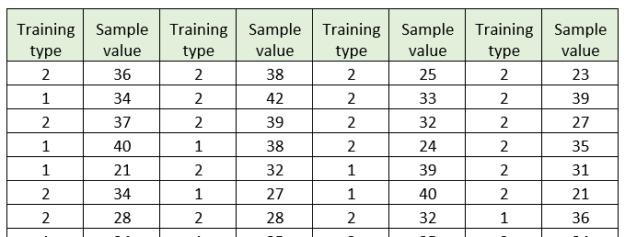
Example 8.7
A company is considering adopting a new method of training for its employees. To assess whether the new method improves employees’ effectiveness, the firm has collected two random samples from the population of employees sitting the examination. Training type 1 employees have studied via the traditional method, and training type 2 employees via the new method. The exam scores are given below in Table 8.33 (partial view).
The firm has analysed previous data and the outcome of the results provides evidence that the distribution is not normally distributed but is skewed to the left.
This information provides concerns about the suitability of using a two-sample independent t test to undertake the analysis. Instead, we decide to use a suitable distribution free test. In this case, the appropriate test is the Mann-Whitney U test.

Slide 43
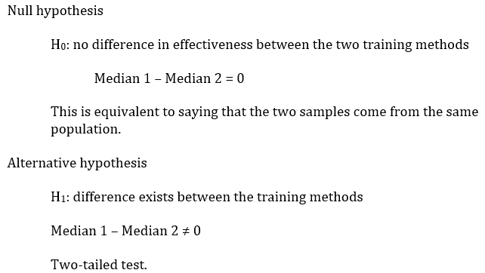
Example 8.7 solution (1/9)
Step 1 - State hypothesis
Step 2 - Select test
  Comparing two independent samples
  Both samples consist of ratio data
  Unknown population distribution
Mann Whitney U test
Step 3 - Set the level of significance (α = 0.05)

Slide 44
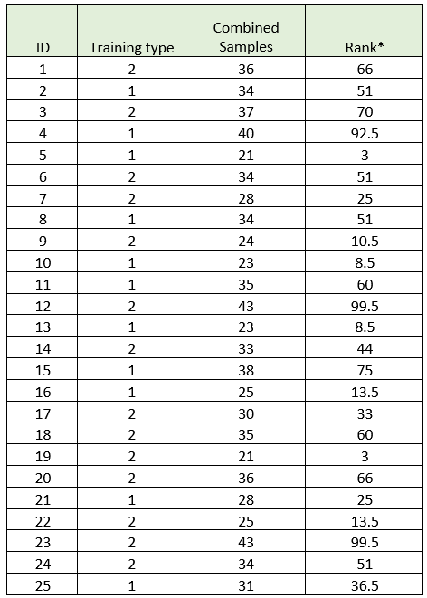
Example 8.7 solution (2/9)
Step 4 - Extract relevant statistic
Input samples into two columns and rank data
Combined sample: sample 1 = 1, and sample 2 = 2. The convention is to assign rank 1 to the smallest value and rank n’ to the largest value. If you have any shared ranks, then the policy is to assign the average rank to each of the shared values.
If you calculate the median value for the two training types, then the median values are Median sample 1 M₁ = 32 and Median sample 2 M₂ = 34. We can observe that the median for sample 2 is larger than for sample 1 (34 > 32). The question now reduces to whether the significance is significant?

Slide 45
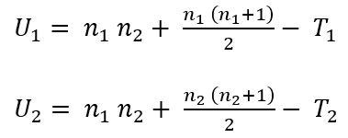
Example 8.7 solution (3/9)
Calculate number of data points in each sample:
Number in sample 1, n₁ = 39
Number in sample 2, n₂ = 8=61
Calculate the sum of the ranks, T₁ and T₂:
T₁ = Sum of sample 1 ranks = 51 + 92.5 + … + 13.5 + 51 = 1778.0
T₂ = Sum of sample 2 ranks = 66 + 70 + … + 33 + 60 = 3273.0
Calculate U₁, U₂ and the test statistic U_{cal}
The value of U1 and U2 are given by equations (7.23) and (7.24)

Slide 46
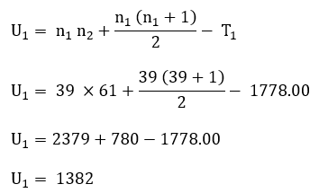
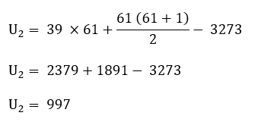
Example 8.7 solution (4/9)
The test statistic U is equal to the difference between the maximum possible values of T for the sample versus the observed values of T: U₁ = T_{1,max} – T₁ and U₂ = T_{2,max} – T₂.
Applying equations (8.22) and (8.23) enables U₁ and U₂ to be calculated:
We only need to calculate either U₁ or U₂ given that we can find the other value from equation (8.24): U₁ + U₂ = n₁ n₂
U₁ + U₂ = 1382 + 997 = 2379
n₁ n₂ = 39 × 61 = 2379

Slide 47

Example 8.7 solution (5/9)
The value of U_{cal} can be either U₁ or U₂ and for this example we will choose U_{cal} = Minimum of U₁ and U₂ = MIN (U₁, U₂).
U_{cal} = Minimum of U₁ and U₂ = MIN (1382, 997) = 997
If the null hypothesis is true, then we would expect U₁ and U₂ both to be centred at the mean value µ_{U} given by equation (8.25).
?????????
$μ_{U}= \frac{n_{1} n_{2}}{2}$ = 1189.5
Therefore, if there is no difference in performance between the old and new training methods, how likely is it that we could end up, by mere chance, with an observed value of U₁ as large as 1389? This is equivalent to asking how likely it is for U₂ to be as small as 997?

Slide 48
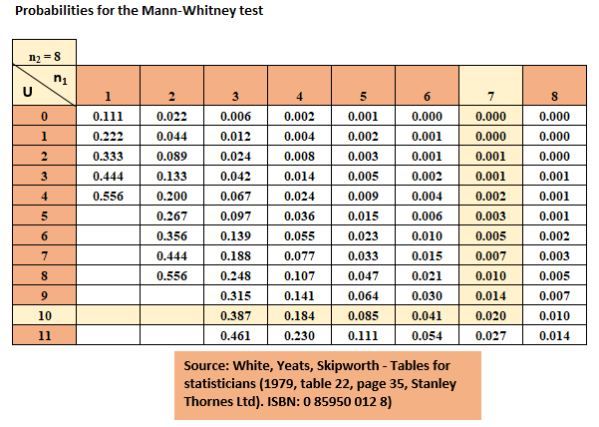
Example 8.7 solution (6/9)
Calculate p-values
For n₁ = 7, n₂ = 8, U = 10, the critical Mann-Whitney one-tail p-value = 0.020.
This is an exact binomial solution.
?????????

Slide 49
Example 8.7 solution (7/9)
Step 5 - Make a decision
?????????
Remember this is a one-tail test.
Compare this p-value with the significance level of 0.05.
Given the exact one-tail p-value = 0.020 < 0.05, reject the null hypothesis and accept the alternative hypothesis.
There is evidence to indicate at a 5% significance level that the effectiveness has improved.

Slide 50




Example 8.7 solution (8/9)
?????????
Normal approximation to the Mann-Whitney test
If the total number of pair wise comparisons (n₁n₂ = 7*8 = 56 > 20) we can approximate the Mann-Whitney distribution with a normal distribution given by equation (7.27).
Where equations (7.28) and (7.29) represent the mean and standard deviation
$Z= \frac{10−28}{8.6410}$ = - 2.0831
The critical Z values can be found from statistical tables: lower one tail z_{cri} = - 1.65. Does the test statistic lie within the region of rejection?
Given Zcal < Zcri (-2.0831 < - 1.65) we accept the alternative hypothesis H₁. There is enough evidence to indicate at a 5% significance level that the effectiveness has improved.

Slide 51
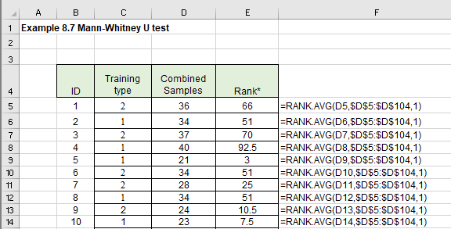
Excel solution (1/3)

Slide 52
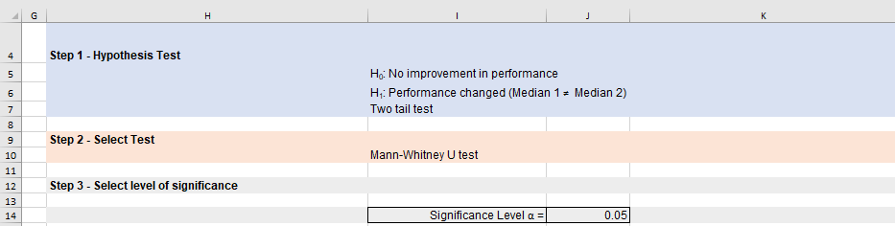
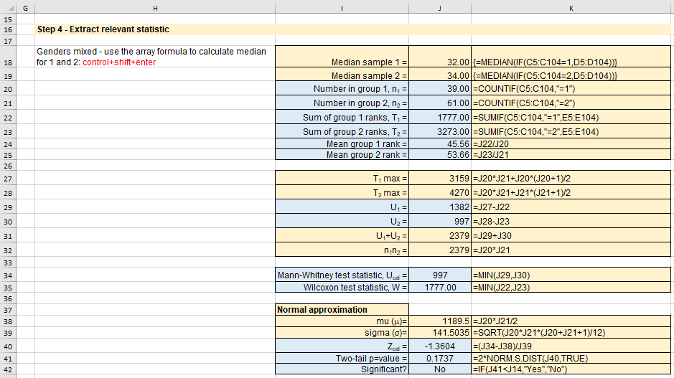
Excel solution (2/3)
?????????
From tables
One-tail p-value = 0.02 < 0.05
Accept H₁

Slide 53
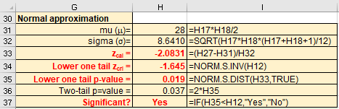
Excel solution (3/3)
Normal approximation
?????????
From Excel:
Mann-Whitney U test statistic = 10
Z test value = - 2.0831
Lower one-tail critical Z value = - 1.645
Exact lower one-tail p-value = 0.019
∴ two-tail p-value = 0.019 * 2 = 0.037
From tables
One-tail p-value = 0.019 < 0.05
Accept H₁

Slide 54
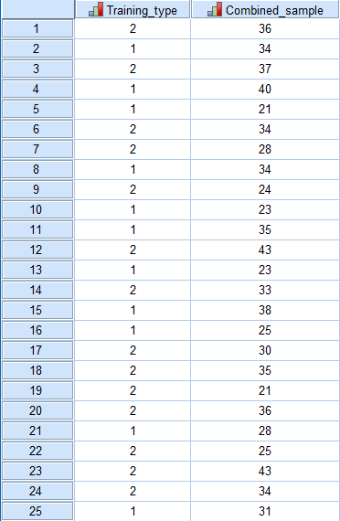
SPSS solution (1/3)
Enter data
The first column is called Training type and the value 1 and 2 represent training methods 1 and 2 respectively.
The second column represents the performance of employees.

Slide 55
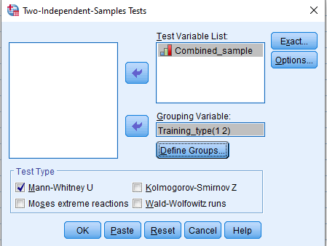
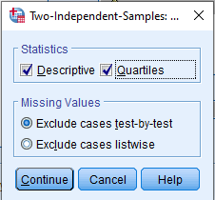
SPSS solution (2/3)
Select Analyze > Nonparametric Tests > Legacy Dialogs > 2 Independent Samples
Transfer Perf to the Test Variable List
Transfer Group to the Grouping Variable box
Click on Define Groups and type 1 and 2 into Group 1 and Group 2 box respectively.
?????????
Click on Exact and choose Exact
Click Continue
Click OK
Click Continue

Slide 56
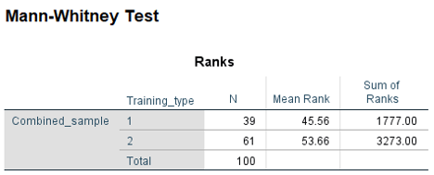
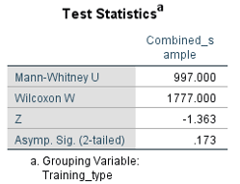
SPSS solution (3/3)
?????????
From SPSS:
Mann-Whitney U test statistic = 10
Asymptotic Z = - 2.091 with two-tail p-value = 0.037. The one-tail p-value would then be 0.037/2 = 0.0019 = 0.02 to 2 decimal places.
These results compare with the Excel solutions of 10, - 2.0831 (slight error due to continuity correction etc), and 0.0019 respectively.
The exact solution gives the one-tail p-value = 0.02 (Excel via MW critical value tables) and 0.020 (SPSS). The agreement with the asymptotic p-value shows that a normal approximation would be an appropriate solution.

Slide 57
Conclusion
Non-parametric hypothesis testing for one and two samples

